Slide 1
Predicting aging inventory

Slide 2
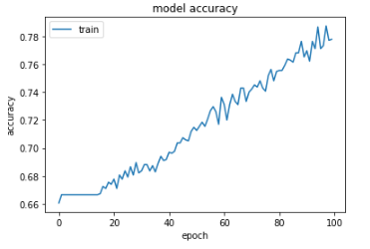
Our Solution
Features used:
3PL id
Inventory id
Category
Company
Target audience
No of days in 3PL
Item count
Release year
Selling price
Demand factor
Assumptions Taken:
Dataset Randomly Generated

Slide 3
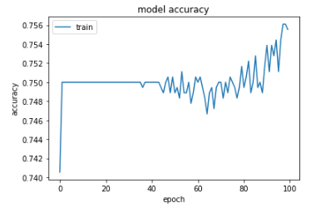
Explore the Dataset and AI Models for individual Strategies
Features used for new 3PL:
3PL id
Inventory id
Category
Company
Target audience
No of days in 3PL
Item count
Release year
Selling price
Demand factor
Best Selling inventory

Slide 4
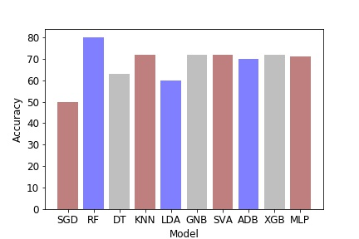
AI model for Social Media Inputs
Features used for Social media:
3PL id
Inventory id
Category
Company
Target audience
No of days in 3PL
Item count
Release year
Selling price
Demand factor
Net Profit
Social inputs used
Predicted Sale

Slide 5
DEMONSTRATION OF THE SYSTEM

Slide 6
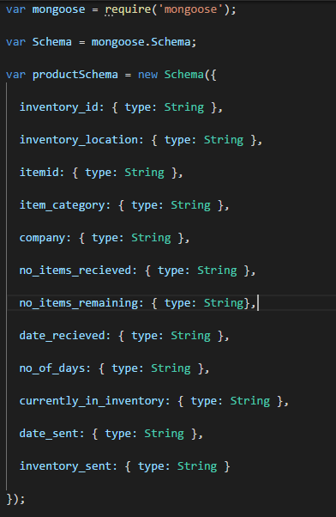
Web development of the system

Slide 7
Future Scope
Using the official dataset, we can find out the people’s history and then use our social media inputs particularly personalized for them.
Prediction of profit can be done on varying the price. New dataset can be made.
Discrepancy report can be automatically generated and inventories having discrepancies can be reported.
Moving to a new 3pl can be updated on the portal itself and the functionality where only a part of Inventory is moved can be implemented as well.

